Slide 1

Vishwakarma Institute of Information Technology
“Weed Detection with AI & IOT”
Name | Roll no. | PRN | Email ID
Sahil Chavan | 332008 | 22210416 | sahil.22210416@viit.ac.in
Shreyash Chile | 332012 | 22210497 | shreyash.22210849@viit.ac.in
Parth Garud | 332015 | 22211522 | parth.22211522@viit.ac.in
Somesh Chincholkar | 332013 | 22210406 | somesh.22210406@viit.ac.in
Vivek Chaudhari | 332006 | 22210566 | vivek.22210566@viit.ac.in
Guided by: Prof. Riddhi Mirajkar
Department of Information Technology , VIIT Pune - 48

Slide 2
Content
Introduction
Literature Survey
Gap Analysis
Proposed System
Methodology
Implementation
Result & Discussion
Conclusion
Future Scope
Department of Information Technology, VIIT Pune - 48

Slide 3
Introduction
Effective weed management is crucial for maximizing crop yield and maintaining sustainable farming practices. Traditional methods often fall short in efficiency and precision.
With the rise of Artificial Intelligence (AI) and the Internet of Things (IoT), innovative solutions are emerging to tackle these agricultural challenges. This project leverages these technologies to create an automated weed detection system.
This system aims to enhance weed identification in real-time using advanced machine learning models and IoT devices, thereby reducing the reliance on manual labor.
By implementing this system, we aim to provide farmers with a powerful tool for precise weed detection, ultimately leading to improved crop management and environmental sustainability.
Department of Information Technology, VIIT Pune - 48

Slide 4
Literature Survey
Year | Aim of the Author | Models or Algorithms | Limitations
2022 | Suggest an enhanced model based on YOLO v4 for detecting weeds in potato fields[1]. | Improved YOLO v4 algorithm | Dataset collected from an experimental field not from there a real field.
2021 | Explores the efficiency of three ML algorithms in weed identification using UAV images. | RF, SVM, KNN | The study conducted in a controlled environment, may not apply to different farms due to soil,weather, and crop varieties.
2022 | Suggests a YOLO v4-tiny model with reduced complexity for identifying weed-infested maize seedlings. | Lightweight YOLO v4-tinymodel CSP Darknet 53-tiny network FPN. | The ability of the suggested model to detect certain objects is limited.
Department of Information Technology, VIIT Pune - 48

Slide 5
Literature Survey
Year | Aim of the Author | Models or Algorithms | Limitations
2022 | Introduces a model for recognizing weeds in soybean fields. | The DeepLabv3+ model, incorporating a Swin transformer and CBAM. | Research did not focus on other crop weed datasets.
2023 | Focuses on creating a lightweight weed detecting system to help laser weeding robots. | YOLO v5 SSD-ResNet5 | The paper does not discuss the limitations or challenges faced during the development.
2022 | This study trained CNN images of various plant species | VGG16 ResNet–50 Xception | Misclassifications occurred due to same morphological characteristics.
Department of Information Technology, VIIT Pune - 48

Slide 6
Literature Survey
Year | Aim of the Author | Models or Algorithms | Limitations
2023 | Focuses on object detection models in pasture environments, specifically weed identification. | SSD SSD Lite Fast R CNN Mask R CNN | The Model doesn’t incorporate additional weed species commonly found in pastures, expanding its applicability and usefulness.
2022 | Demonstrates that can indirectly detect weeds by identifying vegetables. | CenterNet YOLO-v3 Faster R-CNN | Not employed for identifying weeds amidst other vegetables.
2022 | Focuses on separating weed objects from input images | R-CNN | No data Augmentation Done.
Department of Information Technology, VIIT Pune - 48

Slide 7
Literature Survey
Year | Aim of the Author | Models or Algorithms | Limitations
2022 | Proposes thereof apixel-level synthesis data augmentation approach and aTIA-YOLOv5networkfordetecting weeds and crops in intricate pasture conditions | TIA-YOLO v5 CFFI ASFF | Model is not tested on a real-time dataset.
2023 | Introduces WeedGan,a generative adversarial network,to augment a weed dataset. | WeedGAN ESRGAN | Not tested on other crop datasets as well as on real field datasets.
2023 | Introduces"DenseHHO",adeeplearn ingframeworkforweed identification usingpre-trainedCNNs. | DenseNet 121 DenseNet 201 HHO algorithm | Only one crop is used for the study.
Department of Information Technology, VIIT Pune - 48

Slide 8
Gap Analysis
Only Focused on Narrow Range of Crops
No Data Augmentation
No Integration with IOT
Limited Ability to distinguish between weed and crop with same color and morphological characteristics
No Real time data transmission
Department of Information Technology, VIIT Pune - 48

Slide 9
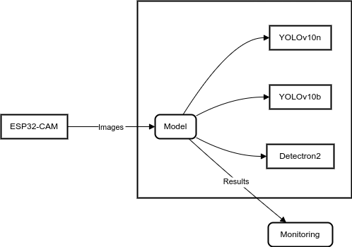
Proposed System & Methodology
Dataset:Trained on a 1.4k image dataset from Roboflow, featuring diverse lighting conditions and focusing on "Crop" and "Weed" classification.
Models: YOLO v10n, YOLO v10b, Detectron2
Data Acquisition: An ESP32-CAM module captures real-time images of the monitored area.
Data Transmission: Images are transmitted via Wi-Fi which can access for the local IP address.
Department of Information Technology, VIIT Pune - 48

Slide 10
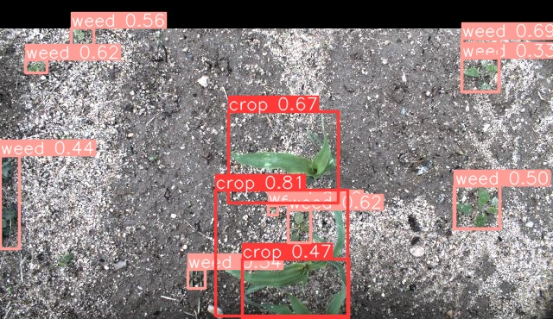
Implementation (AI Part)
Remote YOLO v10b Inference: Images from the ESP32-CAM were transmitted over Wifi to a server/PC. Python script (main.py), using OpenCV, processed these images and performed weed detection using a pre-trained YOLO v10n model.
Visualization: Detected weeds were highlighted with bounding boxes on the video feed displayed on the PC.
Department of Information Technology, VIIT Pune - 48

Slide 11
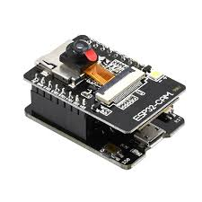
Implementation (IOT Part)
ESP32-CAM Video Capture:
Created a ESP32 CAM Webserver and flashed it’s code in ESP32 CAM using micro-usb.
So that we can stream video using that CAM Module.
Then created a python script which will continuously compare (test) our streamed video with Dataset.
And thus we can see labelled boxes on our streamed video which will tell us which is weed and which is crop.
Department of Information Technology, VIIT Pune - 48

Slide 12
Result & Discussion
Results:
YOLO v10n: Provided real-time detection with minimal latency, making it ideal for edge devices like the ESP32, achieving an precision of approximately 89% on 50 epoch. It was highly efficient for lightweight operations.
YOLO v10b: Delivered higher precision (90%) compared to YOLO v10n but at the cost of slightly increased processing time. It balanced both speed and accuracy effectively.
Detectron2: Trained for 500 iteration and in terms of detection it produced accuracy of 83%, especially in complex images with overlapping weeds. However, it required more computational resources and was slower than both YOLO variants
Department of Information Technology, VIIT Pune - 48

Slide 13
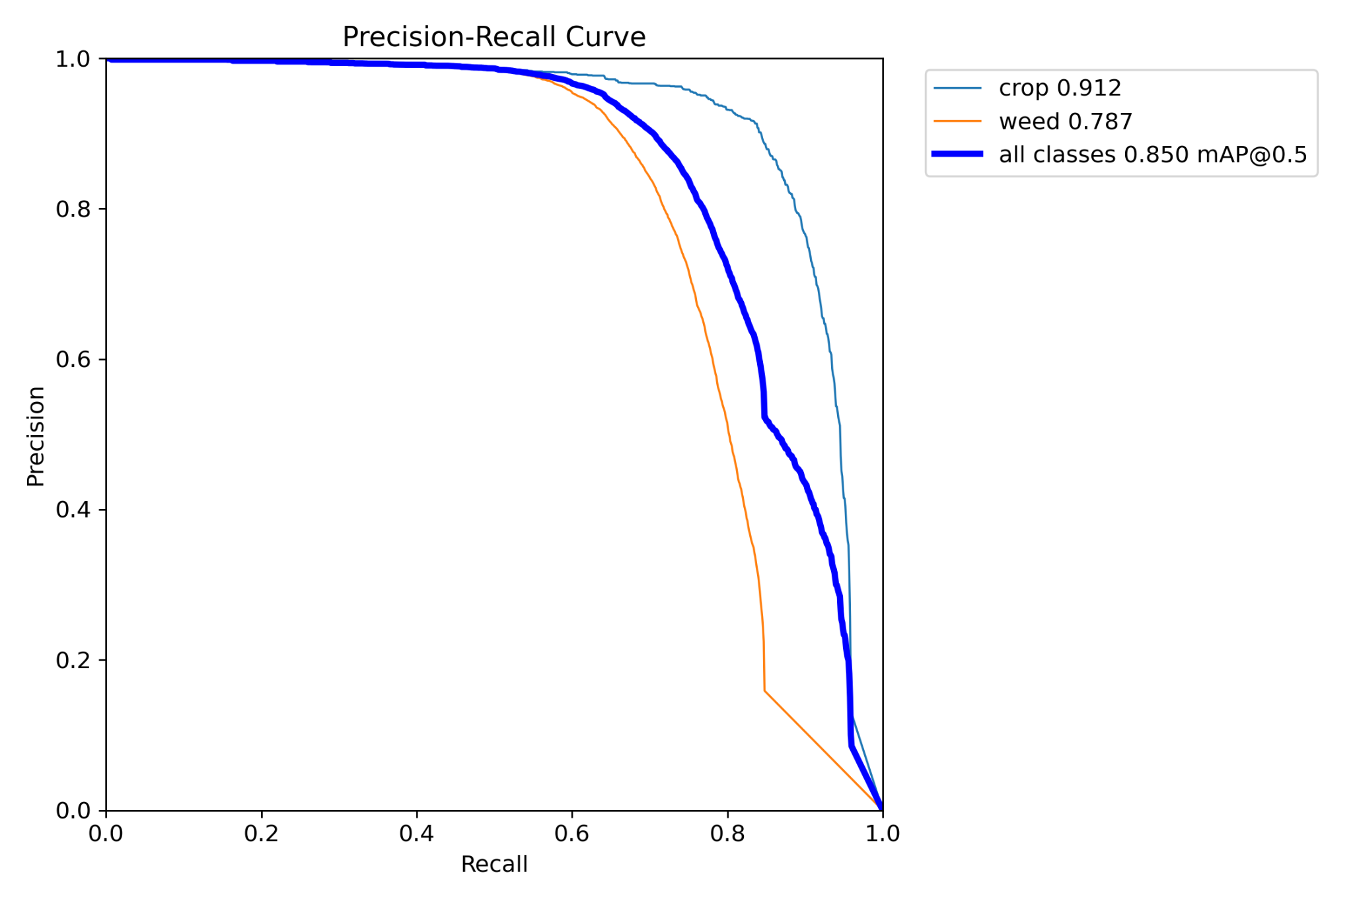
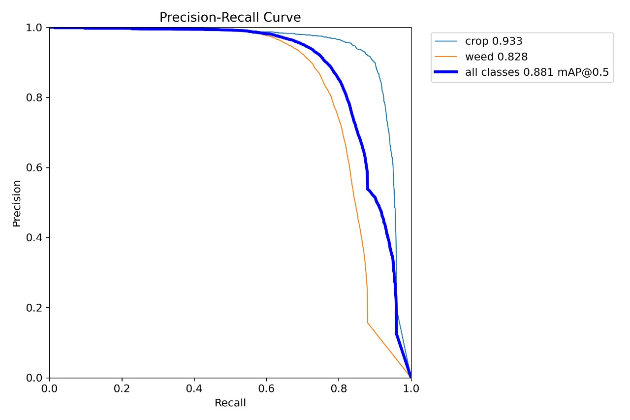
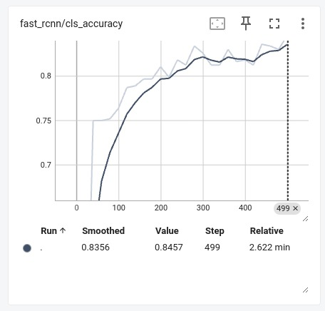
Graphs
YOLO v10n
YOLO v10b
Detectron 2
Department of Information Technology, VIIT Pune - 48

Slide 14
Conclusion
Reducing labor costs and time: Automating weed identification eliminates the need for manual labor, saving farmers significant time and resources.
Increasing efficiency: Real-time monitoring allows for immediate responses to weed infestations, preventing their spread and minimizing crop damage.
Enabling precision herbicide application: By precisely identifying weed locations, the system facilitates targeted herbicide application, reducing chemical use and minimizing environmental impact. This also leads to cost savings for the farmer by not using unnecessary herbicides.
Improving crop yields: Effective weed control directly translates to healthier plants, higher yields, and increased profitability.
Facilitating data-driven decision making: The system can generate valuable data on weed prevalence and distribution, which can inform future management strategies.
Department of Information Technology, VIIT Pune - 48

Slide 15
Future Scope
On-Device Deployment: Explore deploying the weed detection model directly on the ESP32-CAM using TensorFlow Lite. This could improve processing speed, reduce latency, and eliminate the need for a constant network connection.
Integration with Robotics: Integrate the system with a robotic weeding platform to automate the weed removal process based on detection results.
Multi-Weed Detection: Expand the system's capabilities to identify and classify different weed species, providing more detailed information to guide targeted weed management strategies.
Field Testing & Robustness: Conduct extensive field tests to evaluate the system's performance under various real-world conditions (lighting, weather) and improve its robustness.
Data Augmentation & Model Refinement: Continuously collect and annotate more images to improve the dataset, fine-tune the model, and enhance its accuracy over time.
Department of Information Technology, VIIT Pune - 48

Slide 16
References
[1] J. Zhao, G. Tian, C. Qiu, B. Gu, K. Zheng, and Q. Liu, “Weed detection in potato fields based on improved yolo v4: Optimal speed and accuracy of weed detection in potato fields,” Electronics, vol. 11, no. 22, p. 3709, 2022.
[2] N. Islam, M. M. Rashid, S. Wibowo, C.-Y. Xu, A. Morshed, S. A. Wasimi, S. Moore,andS.M.Rahman,“Early weed detection using image processing and machine learning techniques in an australian chilli farm,” Agriculture, vol. 11, no. 5, p. 387, 2021.
[3] S. Liu, Y. Jin, Z. Ruan, Z. Ma, R. Gao, and Z. Su, “Real-time detection of seedling maize weeds in sustainable agriculture,” Sustainability, vol. 14, no. 22, p. 15088, 2022.
[4] H. Yu, M. Che, H. Yu, and J. Zhang, “Development of weed detection method in soybean fields utilizing improved deeplabv3+ platform,” Agronomy, vol. 12, no. 11, p. 2889, 2022.
[5] H. S. Fatima, I. ul Hassan, S. Hasan, M. Khurram, D. Stricker, and M. Z. Afzal, “Formation of a lightweight, deep learning-based weed detection system for a commercial autonomous laser weeding robot,” Applied Sciences, vol. 13, no. 6, p. 3997, 2023.
[6] G. G. Peteinatos, P. Reichel, J. Karouta, D. Andújar, and R. Gerhards, “Weed identification in maize, sunflower, and potatoes with the aid of convolutional neural networks,” Remote Sensing, vol. 12, no. 24, p. 4185
Department of Information Technology, VIIT Pune - 48

Slide 17
References
[7] H. Chegini, F. Beltran, and A. Mahanti, “Designing and developing a weed detection model for california thistle,” ACM Transactions on Internet Technology, vol. 23, no. 3, pp. 1–29, 2023.
[8] X. Jin, Y. Sun, J. Che, M. Bagavathiannan, J. Yu, and Y. Chen, “A novel deep learning-based method for detection of weeds in vegetables,” Pest Management Science, vol. 78, no. 5, pp. 1861–1869, 2022.
[9] M. Vaidehi and C. Malathy, “An unique model for weed and paddy detection using regional convolutional neural networks,” Acta Agriculturae Scandinavica, Section B—Soil & Plant Science, vol. 72, no. 1, pp. 463 475, 2022.
[10] A. Wang, T. Peng, H. Cao, Y. Xu, X. Wei, and B. Cui, “Tia-yolo v5: An improved yolo v5 network for real-time detection of crop and weed in the field,” Frontiers in Plant Science, vol. 13, p. 1091655, 2022.
[11] V. Sharma, A. K. Tripathi, H. Mittal, A. Parmar, A. Soni, and R. Amar wal, “Weedgan: a novel generative adversarial network for cotton weed identification,” The Visual Computer, vol. 39, no. 12, pp. 6503–6519, 2023.
[12] F. R. PP, W. N. Ismail, and M. A. Ali, “A metaheuristic harris hawks optimization algorithm for weed detection using drone images,” Applied Sciences, vol. 13, no. 12, p. 7083, 2023.
Department of Information Technology, VIIT Pune - 48

Slide 18

Department of Information Technology, VIIT Pune - 48

